Slide 1
Mentor Introductions
SIMCODES 2025

Slide 2

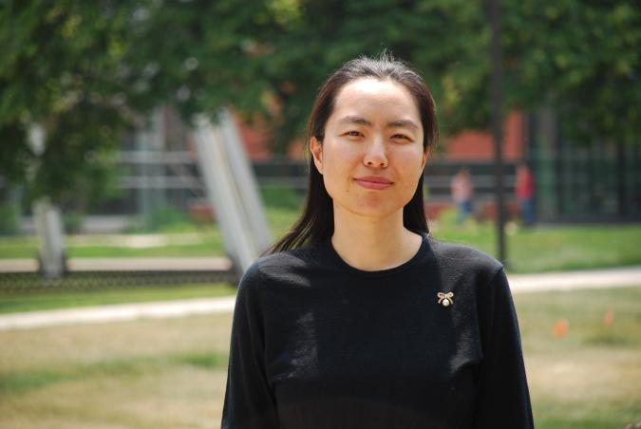
Qi Li
My name
Name can tell a lot
Gender, Ethnicity, Age, Religion, …
Important feature for many NLP tasks
My background
BS. Math
MS. Stats
PhD. CS
Computer Science

Slide 3
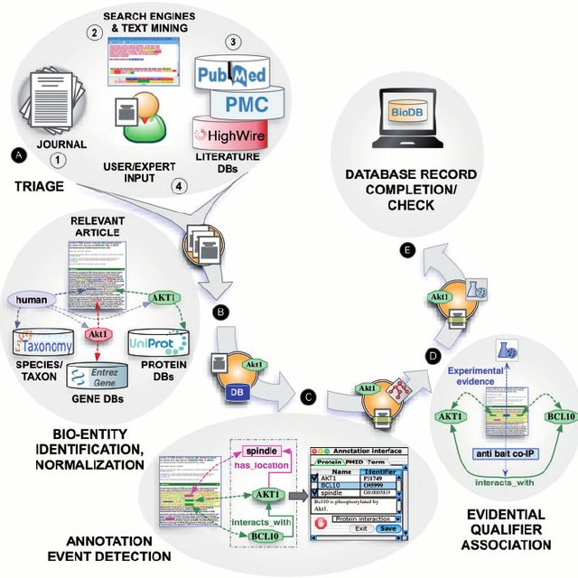

My research
NLP -- Information extraction
Generation models
Applied ML
Knowledge & Insights
Computer Science

Slide 4
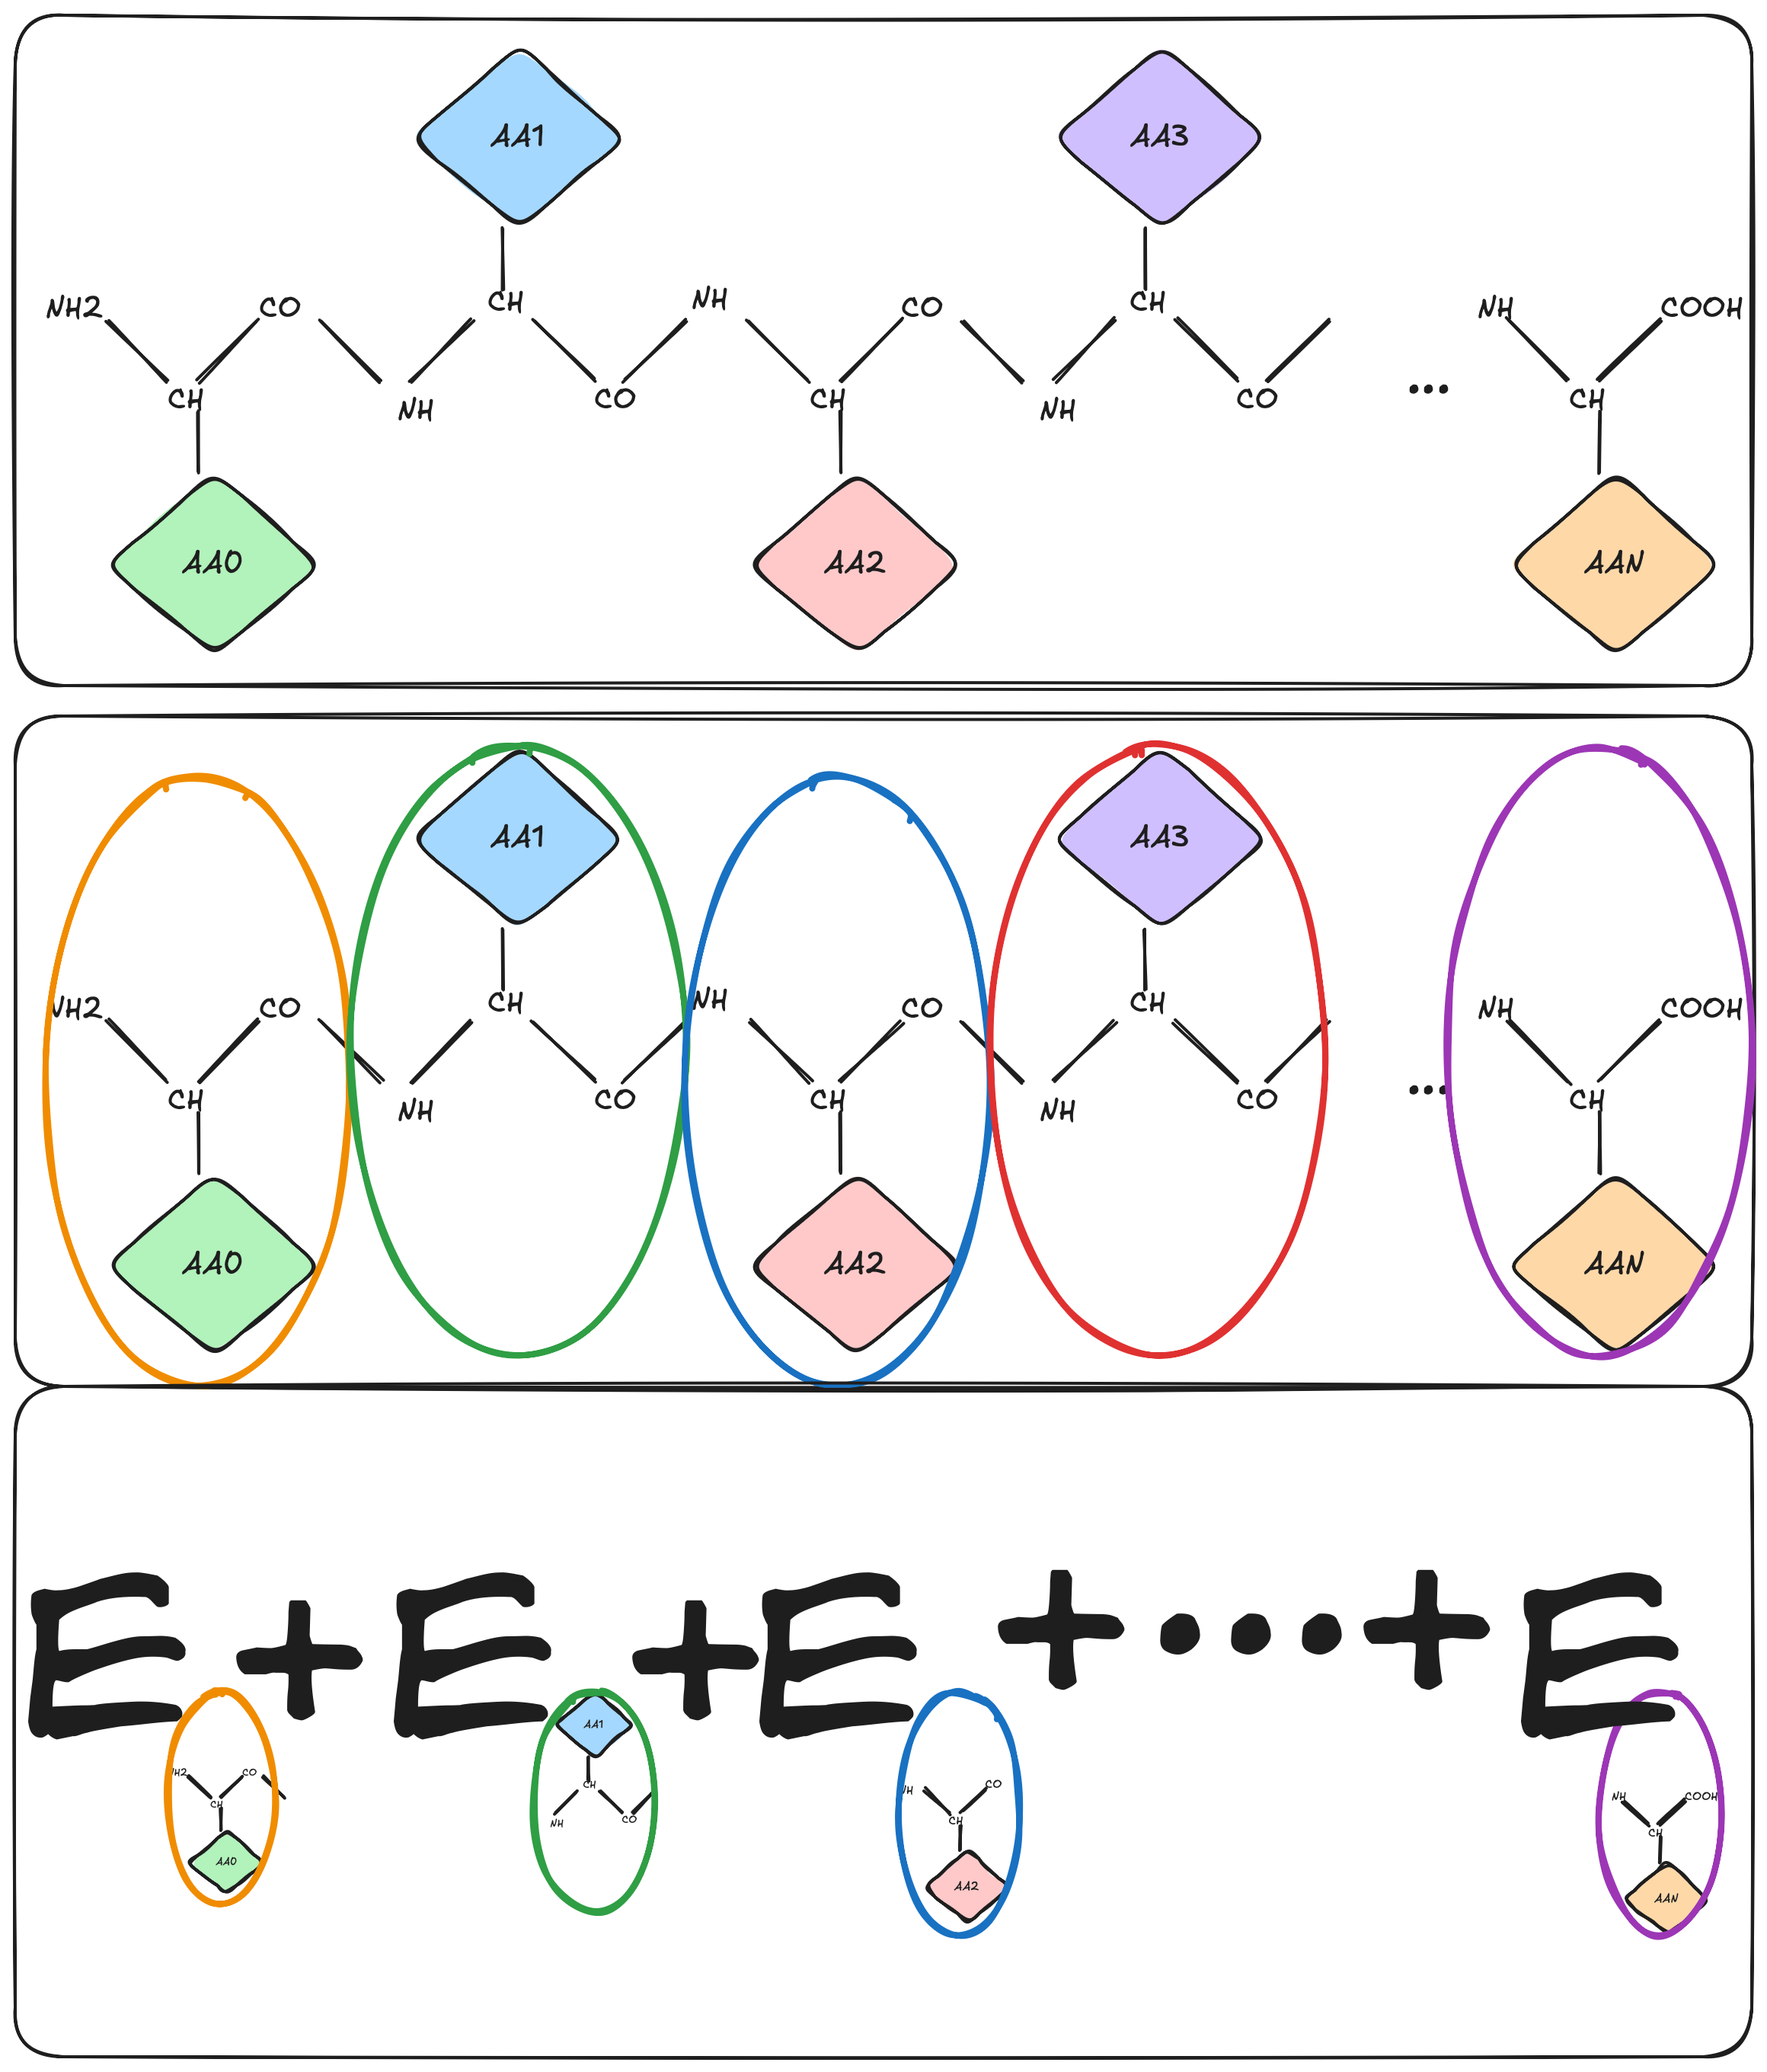
SIMCODES Project: Developing components for automating fragmentation
Mentee: Gabriela and Devarsh
Goals:
Function for identifying amino acids in a protein.
Function for splitting a protein by amino acid.
Idea: protein as an unnatural language
Computer Science

Slide 5
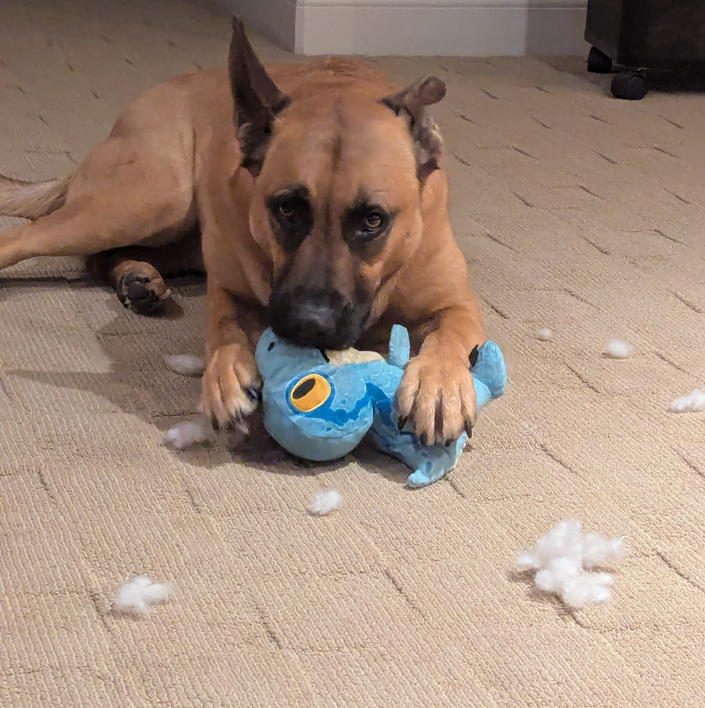
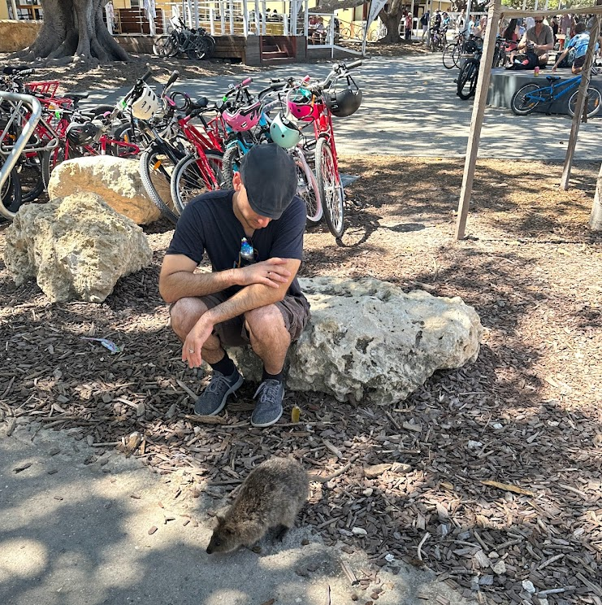
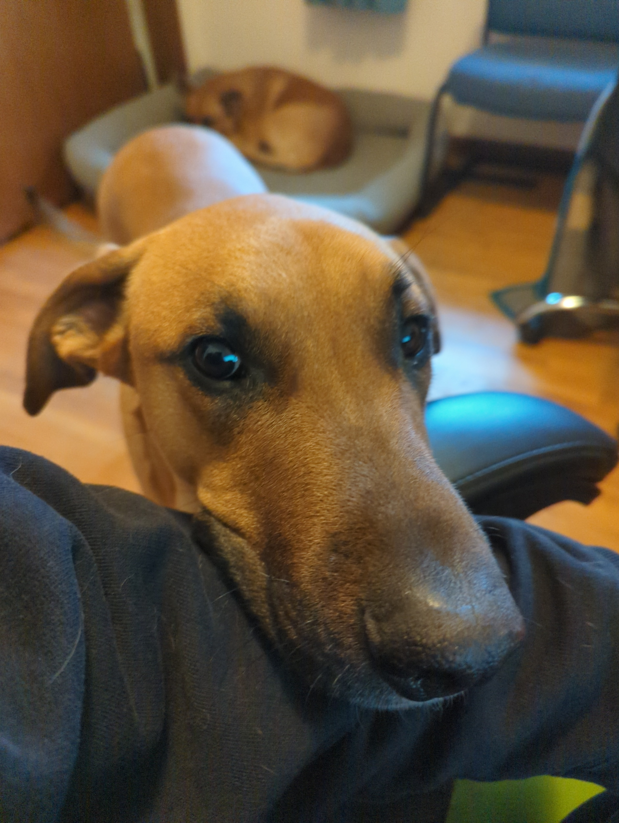
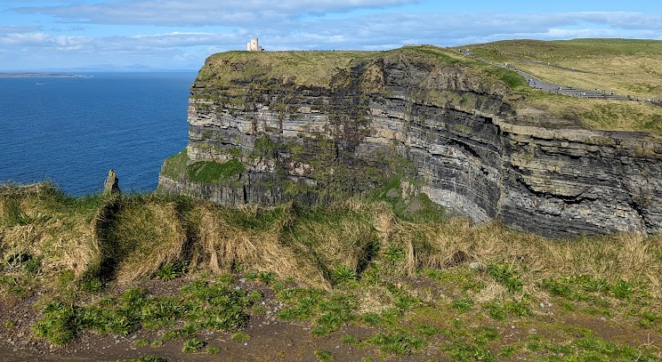
Ryan Richard
Scientist at Ames National Laboratory and Adjunct Professor of Chemistry at Iowa State University.
Background: Grew up in Ohio, PhD in chemistry from “The” Ohio State University.
Interests: travel, technology, video games, exercise, being told what to do by my dogs.

Slide 6
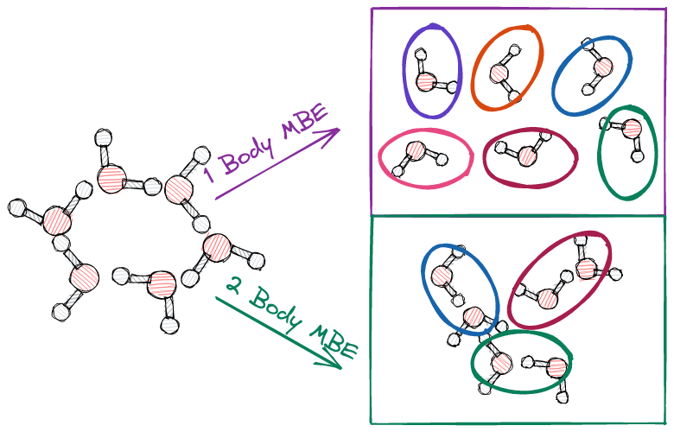
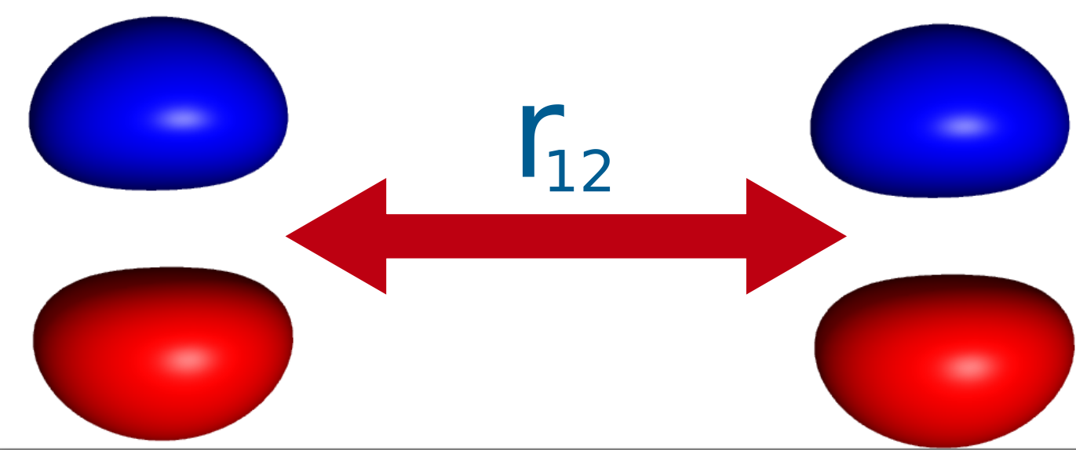
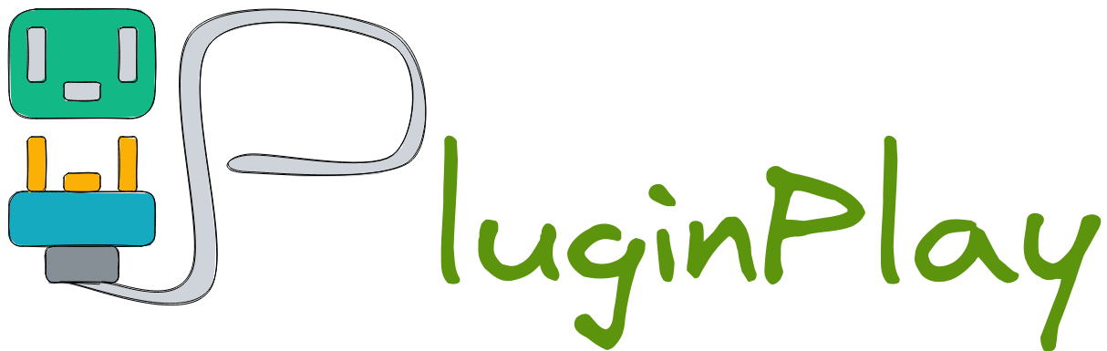
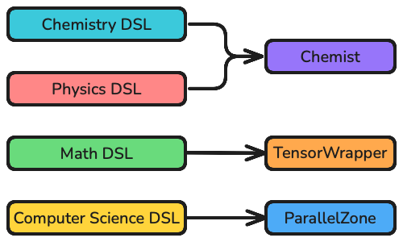

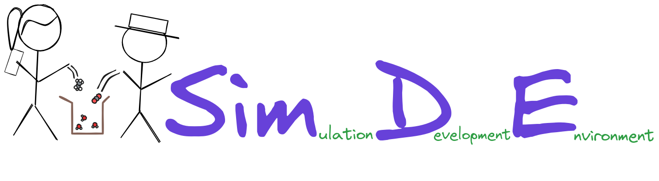
Research in the Richard Group
Research interests: Sustainable scientific software development, high-performance computing, reduced scaling electronic structure theory.
Develop for NWChemEx ecosystem.
Strong emphasis on software engineering applied to theoretical chemistry.
Notes:
The Richard group actively develops software that relies on physics models to predict and explain chemistry. We are particularly interested in developing “reduced scaling techniques”. Fragment-based methods compute the properties of large chemical systems by systematically including molecular interactions. On the other hand, DLPNO-CC systematically includes intramolecular interactions. Both methods have shown great promise in making electronic structure methods more applicable. Our group develops software to be part of the NWChemEx ecosystem.

Slide 7
SIMCODES Project: Developing components for automating fragmentation
Mentee: Daniel Woodard
Summary: Winner-take-all battle between Daniel’s chemical intuition and the best AI/ML model Gabriela and Devarsh can make.
Goals:
Develop tools for reading PDF files.
Function for identifying amino acids in a protein.
Function for splitting a protein by amino acid.

Slide 8
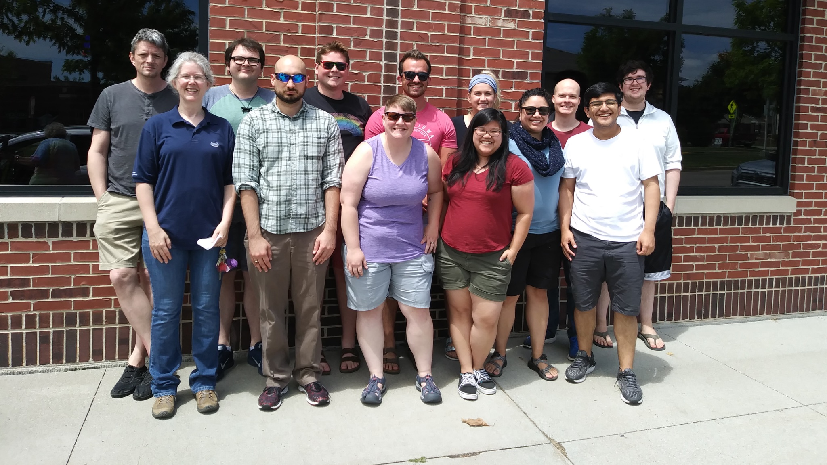
The Richard and Windus Groups
Notes:
The Richard group currently consists of 1 undergraduate student and 3 graduate students. Since Ryan is an adjunct professor he must co-advise graduate students. In practice, this means most students are co-advised by Prof. Theresa Windus (the principal investigator of the NWChemEx project). Other co-advising situations are possible, for example, one graduate student is currently co-advised by Prof. Davit Potoyan.

Slide 9
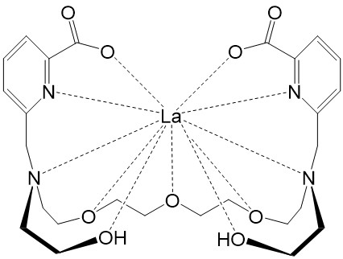
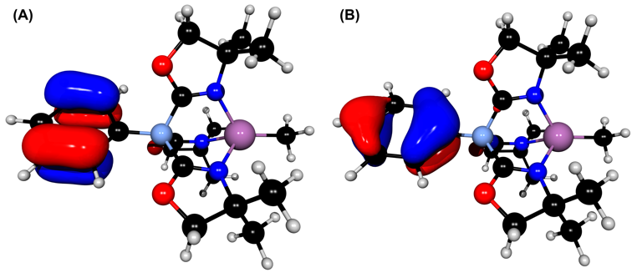
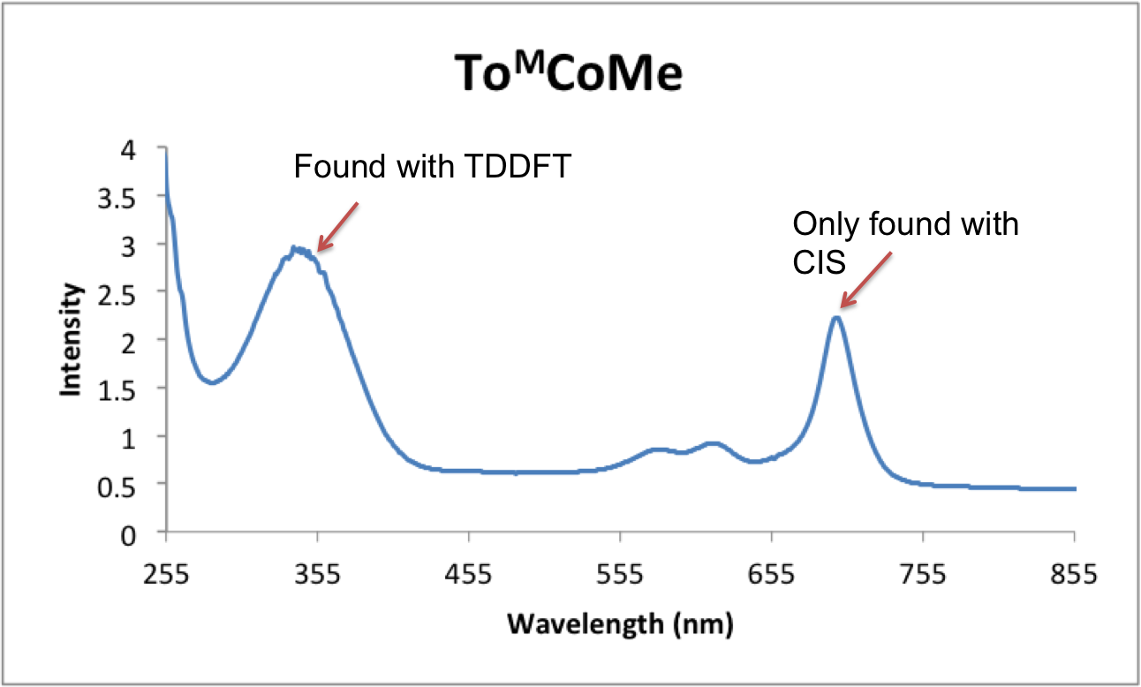
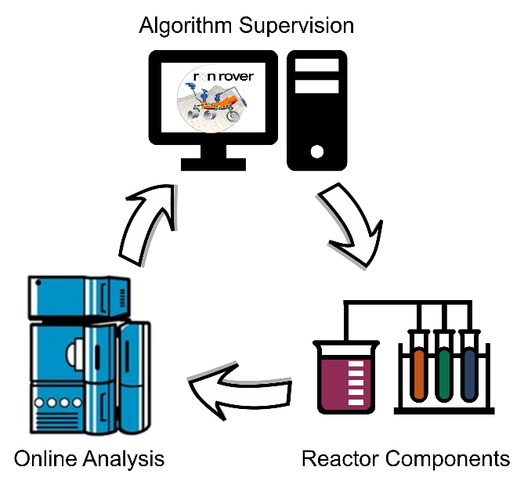
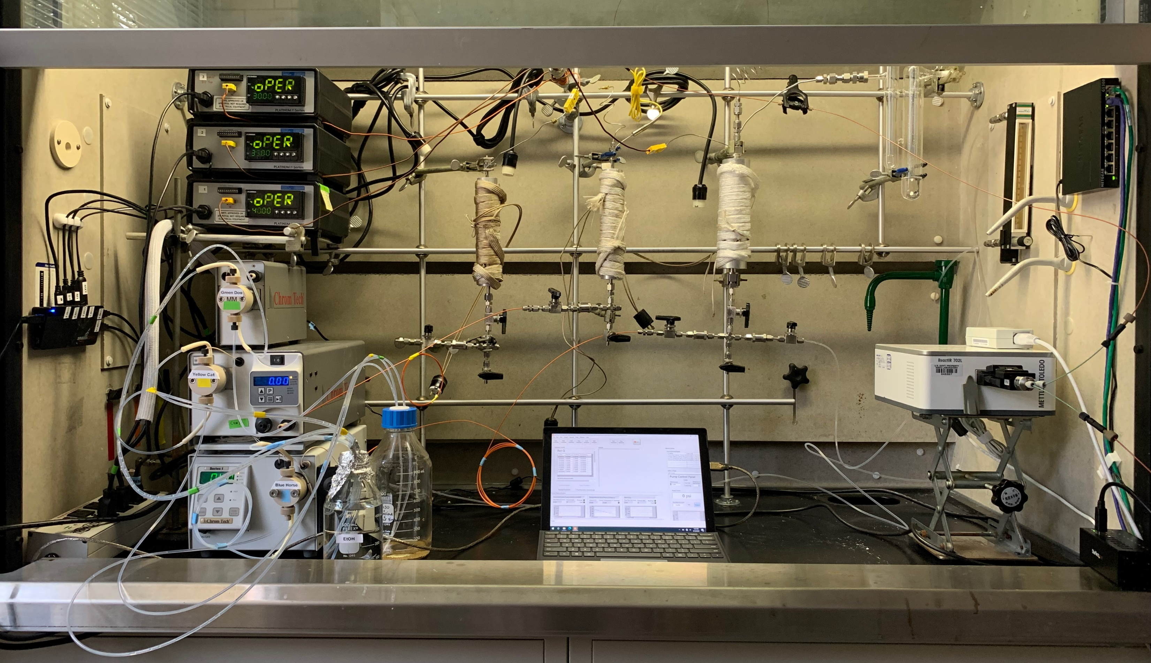
The Windus Group
Separations and catalysis challenges
High performance, exascale computing
Driver
Gradient
Energy
Energy
Execution Time
Gradient
Energy
Energy
Reaction optimization and lab automation
CCA Driver
Gradient
Gradient
E
E
E
E
E
E
E
E
Execution Time
Gradient
Gradient
E
E
E
E
E
E
E
E
Nodes
Notes:
The primary goal of the Windus group is to develop new theoretical and computational methods to understand and facilitate chemical reactions. In particular, we are currently very focused on the development of methods that improve our understanding of heavy element separations and catalysis. We often work with experimentalists to help them understand the reactions that are going on in their synthesis or catalysis. This helps to drive our method and algorithm development. For example, we have been working in the area of reaction optimization and lab automation and have created the software Rxn Rover (pronounced Reaction Rover), that optimizes the product formation in continuous flow reactors. This includes automation of the pumps, temperature controllers, analysis techniques (such as IR, NMR, and HPLC), and optimization techniques working together to enable a full system that requires very little human interaction for reaction optimization. This also includes our recent developments of machine learning models for reaction optimization and the development of ligands for separation of critical materials. Our group is also very involved in the development of high-performance algorithms for new and emerging computer architectures (such as the exascale systems that have just recently been delivered). Students in the Windus group learn collaborative science that includes an understanding of theory, mathematics, computer science, and chemistry.

Slide 10
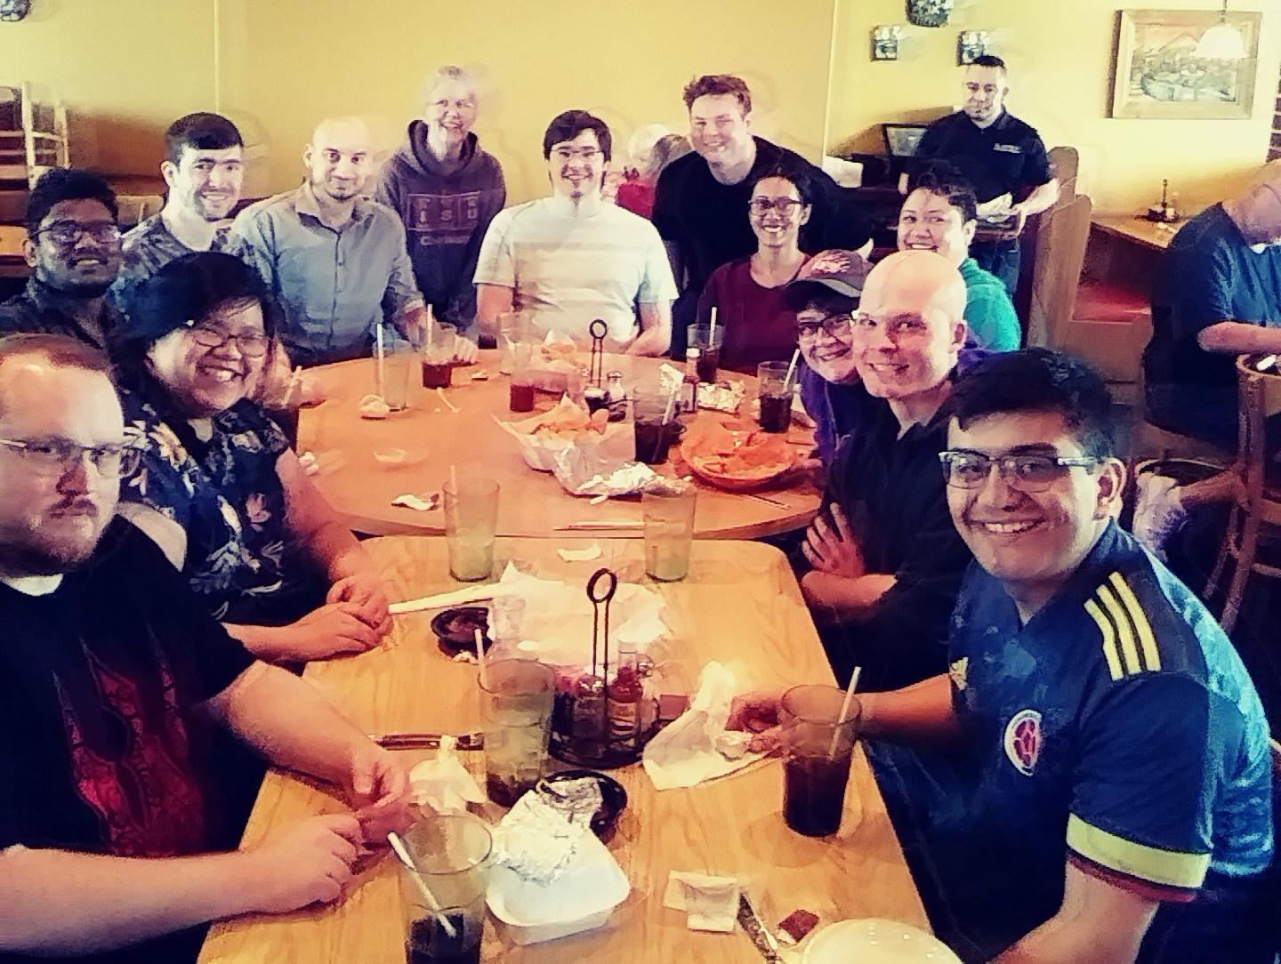







The Windus Group and Funding
Notes:
The Windus group is currently home to 5 graduate students (4 shared). 3 are international students from Sri Lanka. Previous group members have gone on to take positions as research faculty, teaching professors, and industrial scientists. The group also consists of 2 postdocs, 2 Ames National Laboratory staff scientists, and several undergraduate researchers.

